Slide 1
Node.js Testing
by Anton Hryshko

Slide 2
Unit Testing of Node.js Application
Unit Testing is a software testing method where individual units/components are tested in isolation. A unit can be described as the smallest testable part of code in an application. Unit testing is generally carried out by developers during the development phase of an application.

Slide 3
Unit Testing of Node.js Application
In Node.js there are many frameworks available for running unit tests.
Some of them are:
Mocha
Jest
Jasmine
AVA

Slide 4
Unit testing for a node application using these frameworks:
Mocha: Mocha is an old and widely used testing framework for node applications. It supports asynchronous operations like callbacks, promises, and async/await. It is a highly extensible and customizable framework that supports different assertions and mocking libraries.

Slide 5
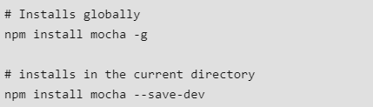
Mocha
To install it, open command prompt and type the following command:

Slide 6

How to use Mocha?
In order to use this framework in your application:
Open the root folder of your project and create a new folder called test in it.
Inside the test folder, create a new file called test.js which will contain all the code related to testing.
open package.json and add the following line in the scripts block.

Slide 7
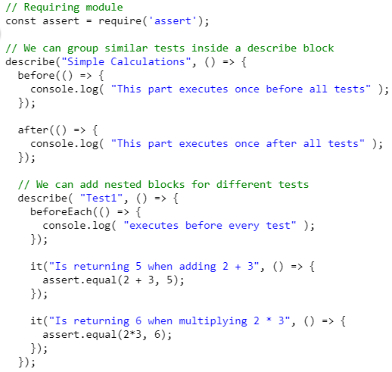
Example

Slide 8
Example
To run these tests, open the command prompt in the root directory of the project and type the following command:
npm run test

Slide 9
Jest
Jest: Jest is also a popular testing framework that is known for its simplicity. It is developed and maintained regularly by Facebook. One of the key features of jest is it is well documented, and it supports parallel test running i.e. each test will run in their own processes to maximize performance. It also includes several features like test watching, coverage, and snapshots.You can install it using the following command:
npm install --save-dev jest
Note: By default, Jest expects to find all the test files in a folder called “__tests__” in your root folder.

Slide 10
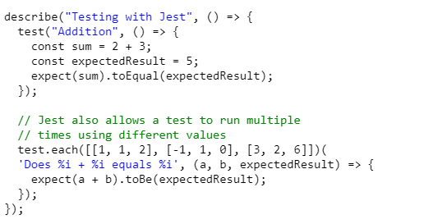
Jest

Slide 11
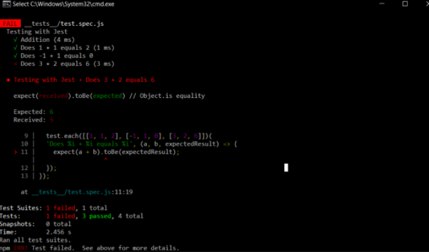
Jest

Slide 12
Jasmine
Jasmine: Jasmine is also a powerful testing framework and has been around since 2010. It is a Behaviour Driven Development(BDD) framework for testing JavaScript code. It is known for its compatibility and flexibility with other testing frameworks like Sinon and Chai. Here test files must have a specific suffix (*spec.js).You can install it using the following command:
npm install jasmine-node
describe("Test", function() {
it("Addition", function() {
var sum = 2 + 3;
expect(sum).toEqual(5);
});
});

Slide 13


